Slide 1
Software Engineering
(CSI 321)
Project Planning &
Estimation

Slide 2
Introduction
Software project management begins with a set of activities that are collectively called project planning.
The software project planner must estimate three things before a project begins:
  How long it will take?
  How much effort will be required?
  How many people will be involved?
In addition, the planner must predict the resources (h/w & s/w) that will be required and the risk involved.

Slide 3
Introduction
Software project planning encompasses five major activities –
    Estimation
    Scheduling
    Risk analysis
    Quality management planning
    Change management planning

Slide 4
Project Planning
The overall goal of project planning is to
establish a logical strategy for controlling,
tracking, and monitoring a complex technical project.
Why?
  So that end result gets done on time, with quality!

Slide 5
The Project Planning Process
The objective of software project planning is to provide a framework that enables the manager to make reasonable estimates of resources, cost, and schedule.
The project plan must be adapted and updated as the project proceeds.
  The more you know, the better you estimate. So, update your estimates as the project progresses.

Slide 6
Task Set for Project Planning
Establish project scope
Determine feasibility
Analyze risks
Define required resources
  Determine human resources required
  Define reusable software resources
  Identify environmental resources

Slide 7
Task Set for Project Planning
5) Estimate Cost and Effort
  Decompose the problem
  Develop two or more estimates using size, function points, process tasks or use-cases
  Reconcile the estimates
6) Develop a project Schedule
  Establish a meaningful task set
  Define a task network
  Use scheduling tools to develop a timeline chart
  Define schedule tracking mechanisms

Slide 8
Estimation
Estimation involves determining how much money, effort, resources and time it will take to build a specific software.
Estimation of resources, cost, and schedule for a software engineering effort requires:
  Experience
  Access to good historical information (metrics)
  The courage to commit to quantitative predictions when qualitative information is all that exists
Estimation carries inherent risk and this risk leads to uncertainty.

Slide 9
To Understand Scope ...
Understand the customers needs
Understand the business context
Understand the project boundaries
Understand the customer’s motivation
Understand the likely paths for change
Understand that ...
Even when you understand,
nothing is guaranteed!

Slide 10
Software Scope
Software scope describes:
  Functions and features that are to be delivered to end-users
  Data that are input and output
  “Content” that is presented to users as a consequence of using the software
  Performance, constraints, interfaces, and reliability that bound the system.
Scope is defined using one of two techniques:
  A narrative description of software scope is developed after communication with all stakeholders.
  A set of use-cases is developed by end-users.

Slide 11
Feasibility
Once software scope is well-understood, it is necessary to determine the feasibility of the software.
Project feasibility is important, BUT a consideration of business need is MORE important. Why?!!?
  ==> It does no good to build a high-tech system that no one wants!
Feasibility study is a crucial part of the estimation process.
  A study that determines whether a requested system makes economic, technical and operational sense for an organization
  Conducted by the Project Manager
  Takes place before the system is constructed

Slide 12
Feasibility
Software feasibility has four solid dimensions –
    Technology
    Finance
    Time
    Resources
Scoping is not enough. Once scope is understood, the software team & others must work to determine if it can be done within these dimensions. This is a crucial part of estimation process (but often overlooked).

Slide 13
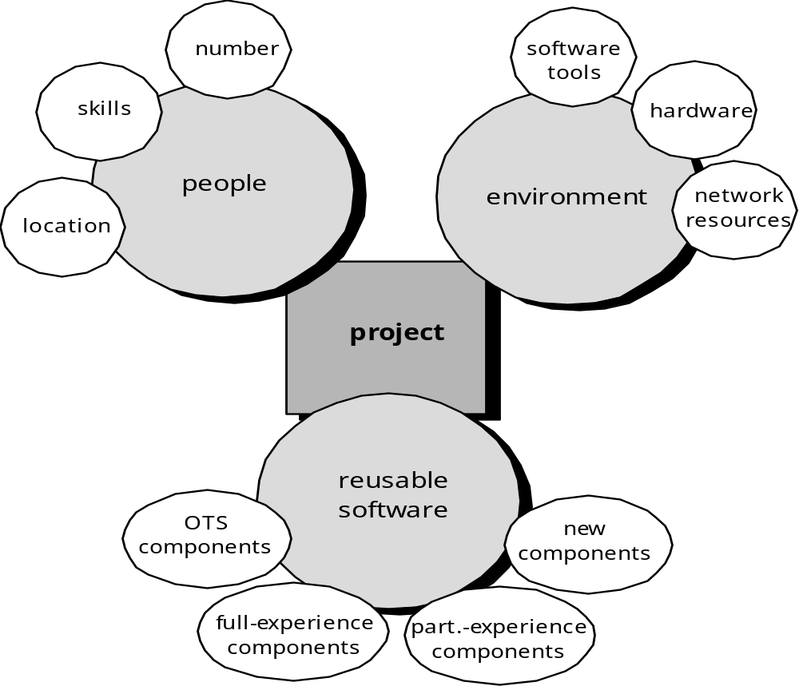
Project Resources

Slide 14
Resource Estimation
The software project planner must conduct an estimation of the resources required to accomplish the software development effort.
Three major categories of software engineering resources –
  People(Human Resources)
  Reusable software components
  Development environment (hardware & software tools)
Each of the resources is specified with four characteristics –
  Description of the resource
  A statement of availability
  When the resource will be required
  Duration of time that resource will be applied

Slide 15
Resource Estimation
Human Resources
  Number of people required and skills needed to complete the development project, location of human resources
Reusable Software Resources
  Off-the-shelf components
  Full-experience components
  Partial-experience components
  New components
Environmental Resources
  Hardware and software required during the development process

Slide 16
Software Project Estimation
Project scope must be explicitly defined
Task and/or functional decomposition is necessary
Historical measures (metrics) are very helpful
At least two different techniques should be used
Remember that uncertainty is inherent in the estimation process

Slide 17
Estimation Options
To achieve reliable cost & effort estimates, a number of options arise –
Delay estimation until late in the project
  not practical
Base estimates on similar projects already completed
  work reasonably well
Use simple decomposition techniques to estimate project cost and effort
Use empirical models for software cost and effort estimation

Slide 18
Estimation Techniques
Past (similar) project experience
Decomposition technique
  task breakdown and effort estimates
  size (e.g., LOC, FP) estimates
Empirical techniques use empirically derived expressions for effort & time estimation

Slide 19
Decomposition Techniques
Size
  Lines of code (LOC) – direct approach
  Function point(FP) – indirect approach
Software sizing
  Fuzzy Logic
  Function Point calculation
  Standard component
  % Change
Process-based estimation
  Decomposition based on tasks required to complete the software process framework

Slide 20
Conventional Methods: LOC/FP Approach
Compute LOC/FP using estimates of information domain values
Use historical data to build estimates for the project

Slide 21
Empirical Estimation Models
Experiential Models
  Typically derived from regression analysis of historical software project data with estimated person-months as the dependent variable
Static Estimation Model
  Does not include time as an independent variable
  COnstructive COst MOdel (COCOMO)
    An algorithmic software cost estimation model developed by Barry Boehm. The model uses a basic regression formula, with parameters that are derived from historical project data and current project characteristics.
Dynamic Estimation Models
  Usually takes time or development phase into account
  Software Equation Model

Slide 22
The Make/Buy Decision
It may be more cost effective to acquire a piece of software rather than develop it.
Decision tree analysis provides a systematic way to sort through the make/buy decision.
As a rule, outsourcing software development requires more skillful management than does in-house development of the same product.

Slide 23
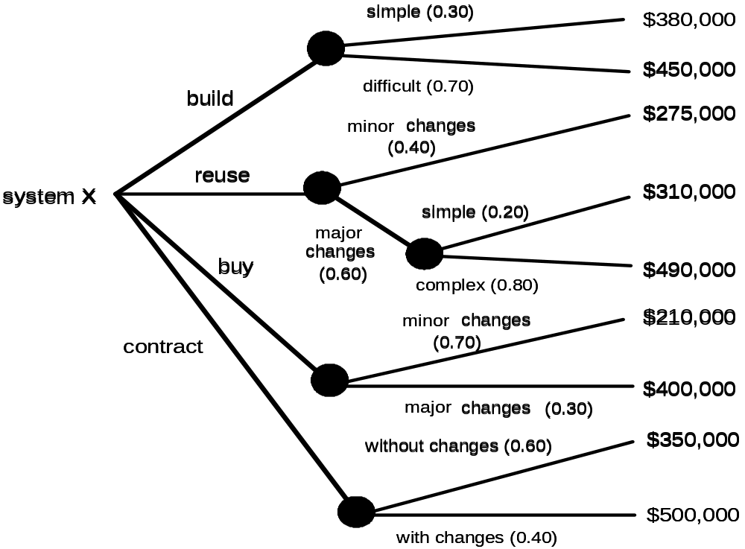
A decision tree helps “Make/Buy Decision”

Slide 24
Computing Expected Cost
expected cost =
(path probability) x (estimated path cost)
i
i
For example, the expected cost to build is:
expected cost = 0.30($380K)+0.70($450K)
= $429 K
build
Similarly,
expected cost = $382K
reuse
expected cost = $267K
buy
expected cost = $410K
contract

Slide 25
The Decision Making Process
Cost is NOT the only criterion to consider while making a decision.
Many other criteria (not just cost ) must be considered during the decision making process.
  Availability
  Experience of the developer/vendor/contractor
  Conformance to requirements
  Local “politics”
  Likelihood of change

Slide 26
Outsourcing
What is outsourcing?
Outsourcing is the practice of turning over responsibility of some or all of an organization's information systems applications and operations to an outside firm.
  Hiring an external vendor, developer, or service provider to create the system
  Requires least amount of resources and little in-house experience
  Gives access to greater resources and experience
  Can be a good alternative for a new system
  Has become quite popular in recent years

Slide 27
Outsourcing
What are the reasons to outsource?
  Cost-effective
  Take advantage of economies of scale
  Free up internal resources
  Reduce time to market
  Increase process efficiencies
  System development is a non-core activity for the organization

Slide 28
Outsourcing
What are the possible risks in outsourcing?
Risks include possibly
  Losing confidential information
  Losing control over future development
  Losing learning opportunities
  Expertise is transferred to the outside organization

Slide 29
Project Estimation: Summary
Software cost & effort estimation will never be an exact science, because too many variables involved –
  Human
  Technical
  Environmental
  Political
But a combination of good historical data and systematic techniques can improve estimation accuracy.

